Slide 1
Angular Training
Kumanan Murugesan
Highbrow Technology
www.highbrowtechnology.com

Slide 2
Software Installation
Chocolatey – Package manager for windows
Don’t need to go to individual web sites
Git – Source control software.
Visual Studio code – IDE for our web development
NodeJS - JavaScript runtime built on top of Chrome V8
Our usage – to install javascript libraries in our project

Slide 3
JavaScript
Programming Language for the web (until 2009)
Developed in two weeks time.
Programming Language for server side, small devices etc
JavaScript != Java
Official name is ECMAScript (ES)
Runs on all browers
But different versions

Slide 4
JavaScript Engine
Computer program that executes your JavaScript code
Runs inside all browsers
Chrome V8 (Chrome)
Spider Monkey (Mozilla)
Chakra ( Safari)

Slide 5
ES Versions
ES3
ES5
ES 6 (ES2015)
ES 7 (ES2016)
ES 8 (ES2017)

Slide 6
Developer toolbar
Tool for developers to see the action behind the scenes
Debug the page, edit html files and css styles watch network activity
Html page contains
css files (styling)
JS files (to make the page dynamic)
Images
Fonts
Etc..

Slide 7
Open Dev tools
MAC - Command+Option+C
Windows - Control+Shift+C

Slide 8
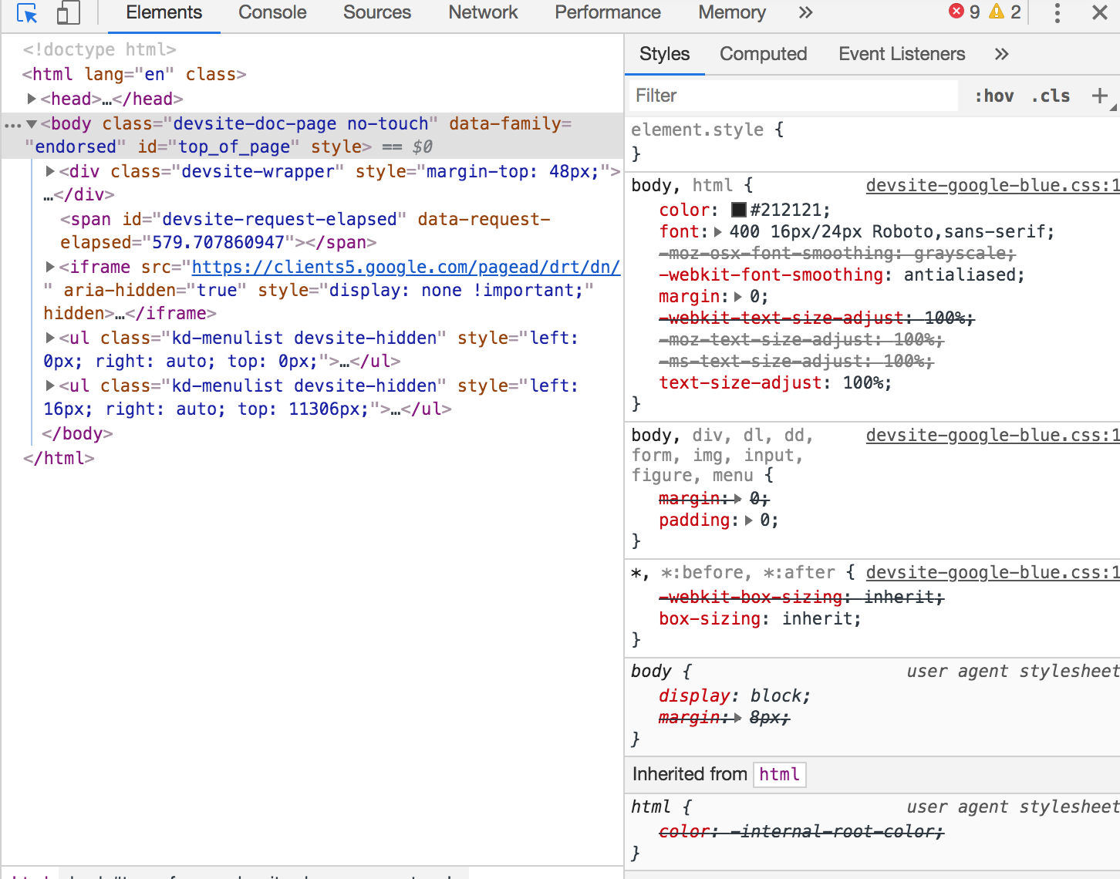

Slide 9
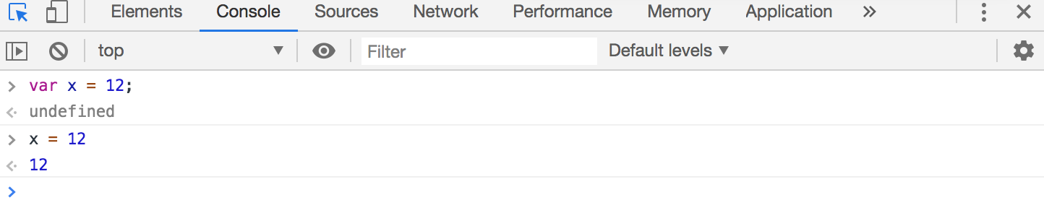

Slide 10
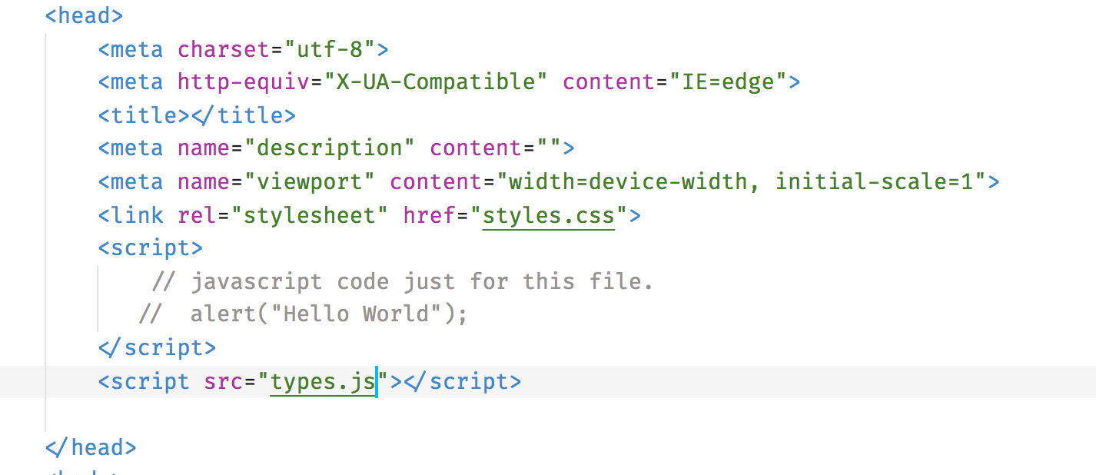
Reference JS Files

Slide 11
Types
numbers
strings
boolean
null – unknown values
undefined – unassigned values
object
symbol (ES6 and later)

Slide 12
Functions
Main building blocks of a program.
Allows the code to be called many times without repletion
function add(number1, number2) {
return number1 + number2;
}

Slide 13
Pluralsight courses
Basics of Programming with JavaScript – Kyle Simpson
Rapid JavaScript Training – Mark Zamatoya
TypeScript Fundamentals – Dan Wahlin
Angular: Getting Started – Deborak Kurata
Angular CLI – John Papa

